Slide 1

< Network layer >
< NETWORK MANAGEMENT >
<SIMPLE NETWORK MANAGEMENT PROTOCOL>
Gouasmia Zakaria
Gouasmia.zakaria1@gmail.com

Slide 2
OUTLINE
WHAT IS NETWORK MANAGEMENT ?
NETWORK MANAGEMENT VOCABULARY

Slide 3
WHAT IS NETWORK MANAGEMENT ?
In the early years , network was small and local .
Network manager’s job includes
  Installation : attach PCs , printers , etc.. To LAN
  Configuration : NICs , protocol stack , user app’s shared printers ….so more
  Testing : ping was sufficient to “manage” network
  More devices :bridge router
  Job was manageable

Slide 4
Above only deals with configuration
Ongoing maintenance issues
  How to optimize performance ?
  How to handle failures and network changes ?
  How to extend network capacity ?
  How to account for network usages ?
  How to solve network security issues ?

Slide 5
  In the past , the network manager might take all the responsibilities
  Today the task has divided into specialties :
    Server admin
    System admin
    Network admin
    Security specialist
    Different certifications for these ….. Cisco , novel , Microsoft

Slide 6
  today , networks are larger and more complicated , so more demands on network manager
  How to monitor and control the network effectively and timely ?
    Management tools are needed

Slide 7
  Network –based management tools :use the network to manage the network (remotely)
    To control
      Simple Network management protocol (SNMP)
      Management information base (MIB)
      Network management system (NMS)
    TO monitor
      Remote monitor (RMON1)

Slide 8
Network management
  Network management includes the deployment , integration and coordination of the hardware , software , and human elements to :
    monitor
    test
    poll
    configure
    analyze
    evaluate and control the network and element resources to meet the real-time , operational performance and quality of service requirements at a reasonable cost .

Slide 9
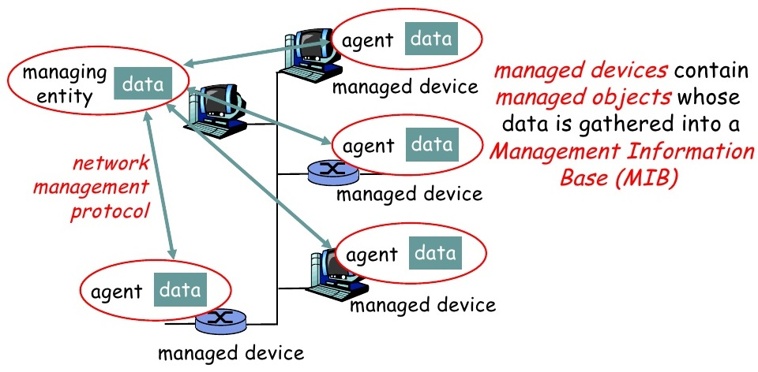
Network management Vocabulary

Slide 10
Network management Vocabulary
Managed Device
  Devices to be monitored/ controlled
  A managed device may have several managed objects to be managed
  A software (agent ) is installed to provide access to information /parameters (data) about the device , which is called Management Information Base (Mib)
Managing Entity
  Used by the manager / admin to do network management
  Pc , netbook , terminal .. Installed with a software called Network Management System (NMS)
  NMS display / analyzes data from management agents

Slide 11
Network management Vocabulary
Network Manager protocol
  Runs between the managing entity and the managed devices
  The managing entity can query the status of the managed devices and take actions at the devices via its agents .
  Agents can use the protocol to inform the managing entity of exceptional events
  E.g .. SNMP : simple Network management protocol
Managing agents located at managed devices are periodically queried by the managing entity through a network management protocol .

Slide 12
SNMP
Simple Network Management Protocol

Slide 13
What is SNMP?
SNMP is a tool (protocol) that allows for remote and local management of items on the network including servers, workstations, routers, switches and other managed devices.
Comprised of agents and managers
Agent - process running on each managed node collecting information about the device it is running on.
Manager - process running on a management workstation that requests information about devices on the network.

Slide 14
Versions
Two major versions SNMPv1, SNMPv2
SNMPv1 is the recommended standard
SNMPv2 has become split into:
SNMPv2u - SNMPv2u with user-based security
SNMPv2* - SNMPv2 with user-based security and additional features
SNMPv2c - SNMPv2 without security

Slide 15
Versions
SNMPv3
Add security and remote configuration
Each SNMP entity has an identifier- snmpEengineID
    Communication for USM- user based Security mode
      NoAuthNoPriv
      authNoPriv
      AuthPriv
      Privacy protocols –CBC _DES, CFB_AES_129

Slide 16
Advantages of using SNMP
Standard
universally supported
extendible
portable
allows distributed management access
Light weight protocol

Slide 17
Client Pull & Server Push
SNMP is a “client pull” model
The management system (client) “pulls” data from the agent (server).
SNMP is a “server push” model
The agent (server) “pushes” out a trap message to a (client) management system

Slide 18
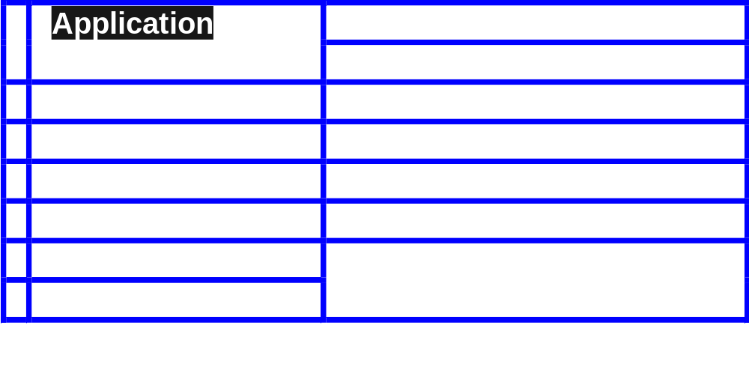
SNMP & The OSI Model

Slide 19
Ports & UDP
SNMP uses User Datagram Protocol (UDP) as the transport mechanism for SNMP messages
Ethernet Frame
IP Packet
SNMP Message
CRC
UDP Datagram
Like FTP, SNMP uses two well-known ports to operate:
UDP Port 161 - SNMP Messages
UDP Port 162 - SNMP Trap Messages

Slide 20
The Three Parts of SNMP
SNMP network management is based on three parts:
SNMP Protocol
Defines format of messages exchanged by management systems and agents.
Specifies the Get, GetNext, Set, and Trap operations
Structure of Management Information (SMI)
Rules specifying the format used to define objects managed on the network that the SNMP protocol accesses
Management Information Base (MIB)
A map of the hierarchical order of all managed objects and how they are accessed

Slide 21
Nodes
Items in an SNMP Network are called nodes. There are different types of nodes.
Managed nodes
Typically runs an agent process that services requests from a management node
Management nodes
Typically a workstation running some network management & monitoring software
Nodes that are not manageable by SNMP
A node may not support SNMP, but may be manageable by SNMP through a proxy agent running on another machine
Nodes can be both managed nodes and a management node at the same time (typically this is the case, since you want to be able to manage the workstation that your management application is running on.)

Slide 22
SNMP Agents
Two basic designs of agents
Extendible Agents
Open, modular design allows for adaptations to new management data and operational requirements
Monolithic Agents
not extendible
optimized for specific hardware platform and OS
this optimization results in less overhead (memory and system resources) and quicker execution

Slide 23
Proxy & Gateway Agents
Proxy & Gateway Agents extend the capabilities of SNMP by allowing it to:
Manage a device that cannot support an SNMP agent
Manage a device that supports a non-SNMP management agent
Allow a non-SNMP management system to access an SNMP agent
Provide firewall-type security to other SNMP agents (UDP packet filtering)
Translate between different formats of SNMP messages (v1 and v2)
Consolidate multiple managed nodes into a single network address (also to provide a single trap destination)

Slide 24
Four Basic Operations
Get
Retrieves the value of a MIB variable stored on the agent machine
(integer, string, or address of another MIB variable)
GetNext
Retrieves the next value of the next lexical MIB variable
Set
Changes the value of a MIB variable
Trap
An unsolicited notification sent by an agent to a management application (typically a notification of something unexpected, like an error)

Slide 25
Traps
Traps are unrequested event reports that are sent to a management system by an SNMP agent process
When a trappable event occurs, a trap message is generated by the agent and is sent to a trap destination (a specific, configured network address)
Many events can be configured to signal a trap, like a network cable fault, failing NIC or Hard Drive, a “General Protection Fault”, or a power supply failure
Traps can also be throttled -- You can limit the number of traps sent per second from the agent
Traps have a priority associated with them -- Critical, Major, Minor, Warning, Marginal, Informational, Normal, Unknown

Slide 26
Trap Receivers
Traps are received by a management application.
Management applications can handle the trap in a few ways:
Poll the agent that sent the trap for more information about the event, and the status of the rest of the machine.
Log the reception of the trap.
Completely ignore the trap.
Management applications can be set up to send off an e-mail, call a voice mail and leave a message, or send an alpha-numeric page to the network administrator’s pager that says:
Your PDC just Blue-Screened at 03:46AM. Have a nice day. :)

Slide 27
Languages of SNMP
Structure of Management Information (SMI)
specifies the format used for defining managed objects that are accessed via the SNMP protocol
Abstract Syntax Notation One (ASN.1)
used to define the format of SNMP messages and managed objects (MIB modules) using an unambiguous data description format
Basic Encoding Rules (BER)
used to encode the SNMP messages into a format suitable for transmission across a network

Slide 28
SMIv1
Structure of Management Information
SMIv1 is described in RFCs 1155, 1212, 1215
These RFCs describe:
How MIB modules are defined with CCITT X.208 ASN.1 data description language
The subset of the ASN.1 language that is used in MIBs
The addition of the APPLICATION data type to ASN.1, specifically for use with SNMP MIBs
All ASN.1 constructs are serialized using the CCITT X.209 BER for transmission across the wire
definition of the high-level structure of the Internet branch (iso(1).org(3).dod(6).internet(1)) of the MIB naming tree
the definition and description of an SNMP managed object

Slide 29
SMIv2
Structure of Management Information
SMIv2 is described in RFCs 1442, 1443, 1444
These RFCs describe:
SMIv2 is a backward compatible update to SMIv1
The only exception is the Counter64 type defined by SMIv2
Counter64 cannot be created in SMIv2
RFC 2089 defines how bilingual (SMIv1 & SMIv2) agents handle the Counter64 data type
IETF requires that new and revised RFCs specify MIB modules using SMIv2

Slide 30
ASN.1
Abstract Syntax Notation One
ASN.1 is nothing more than a language definition. It is similar to C/C++ and other programming languages.
Syntax examples:
-- two dashes is a comment -- The C equivalent is written in the comment
MostSevereAlarm ::= INTEGER -- typedef MostSevereAlarm int;
circuitAlarms MostSevereAlarm ::= 3 -- MostSevereAlarm circuitAlarms = 3;
MostSevereAlarm ::= INTEGER (1..5) -- specify a valid range
ErrorCounts ::= SEQUENCE {
circuitID OCTET STRING,
erroredSeconds INTEGER,
unavailableSeconds INTEGER
} -- data structures are defined using the SEQUENCE keyword

Slide 31
BER
Basic Encoding Rules
The relationship between ASN.1 and BER parallels that of source code and machine code.
CCITT X.209 specifies the Basic Encoding Rules
All SNMP messages are converted / serialized from ASN.1 notation into smaller, binary data (BER)

Slide 32
SNMP Data Types
Yellow items defined by ASN.1
Orange items defined by RFC 1155
INTEGER -- signed 32-bit integer
OCTET STRING
OBJECT IDENTIFIER (OID)
NULL -- not actually data type, but data value
IpAddress -- OCTET STRING of size 4, in network byte order (B.E.)
Counter -- unsigned 32-bit integer (rolls over)
Gauge -- unsigned 32-bit integer (will top out and stay there)
TimeTicks -- unsigned 32-bit integer (rolls over after 497 days)
Opaque -- used to create new data types not in SNMPv1
DateAndTime, DisplayString, MacAddress, PhysAddress, TimeInterval, TimeStamp, TruthValue, VariablePointer -- textual conventions used as types

Slide 33
Managed “Objects” & MIBs
Always defined and referenced within the context of a MIB
A typical MIB variable definition:
sysContact OBJECT-TYPE -- OBJECT-TYPE is a macro
SYNTAX DisplayString (SIZE (0..255))
ACCESS read-write -- or read-write, write-only, not-accessible
STATUS mandatory -- or optional, deprecated, obsolete
DESCRIPTION
“Chris Francois
cfrancois@acm.org
(360)650-0000”
::= { system 4 }

Slide 34
Basic Message Format
Message Length
Message Version
Message Preamble
Community String
PDU Header
SNMP Protocol Data Unit
PDU Body

Slide 35
SNMP Message Formats
Message Length
SNMP Message Preamble
Message Version
Message Length
Community String
Message Version
PDU Type
Community String
PDU Length
PDU Type
PDU Length
Enterprises MIB OID
PDU Header
Agent IP Address
Request ID
Standard Trap Type
Error Status
Specific Trap Type
Error Index
Time Stamp
Length of Variable Bindings
Length of Variable Bindings
Length of First Binding
Length of First Binding
OID of First Binding
OID of First Binding
Type of First Binding
Type of First Binding
Value of First Binding
PDU Body
Value of First Binding
Length of Second Binding
Length of Second Binding
OID of Second Binding
OID of Second Binding
Type of Second Binding
Type of Second Binding
Value of Second Binding
Value of Second Binding
Additional Variable Bindings
Additional Variable Bindings

Slide 36
Commercial SNMP Applications
Here are some of the various SNMP Management products available today:
http://www.hp.com/go/openview/ HP OpenView
http://www.tivoli.com/ IBM NetView
http://www.novell.com/products/managewise/ Novell ManageWise
http://www.sun.com/solstice/ Sun MicroSystems Solstice
http://www.microsoft.com/smsmgmt/ Microsoft SMS Server
http://www.compaq.com/products/servers/management/ Compaq Insight Manger
http://www.redpt.com/ SnmpQL - ODBC Compliant
http://www.empiretech.com/ Empire Technologies
ftp://ftp.cinco.com/users/cinco/demo/ Cinco Networks NetXray
http://www.netinst.com/html/snmp.html SNMP Collector (Win9X/NT)
http://www.netinst.com/html/Observer.html Observer
http://www.gordian.com/products_technologies/snmp.html Gordian’s SNMP Agent
http://www.castlerock.com/ Castle Rock Computing
http://www.adventnet.com/ Advent Network Management
http://www.smplsft.com/ SimpleAgent, SimpleTester

